Slide 1
GSBO city collision data analysis
Team 6
-Vanteru Sahithi
-Jorge Salas
-Daniel Fyre
-Jin Kang
-Dimithra Rathnayake

Slide 2
Tasks by each member.
Sahithi Vanteru - Poisson distribution between accidents on weekends and weekdays and time intervals ,hypothesis testing.
Jin Kang - Correlation between Greensboro population and collision
Daniel Frye - Correlation between Intersections and collisions
Jorge Salas - Fatality Statistics over time of day, months, and year
Dimithra Ratnayake - Analysing effects of different types of collisions

Slide 3
Distribution modeling.
Made a poisson distribution model for 2 sets of data:
Distribution of frequency of accidents during weekdays against the frequency of accidents during weekends.
Distribution of frequency of accidents in different time intervals.

Slide 4
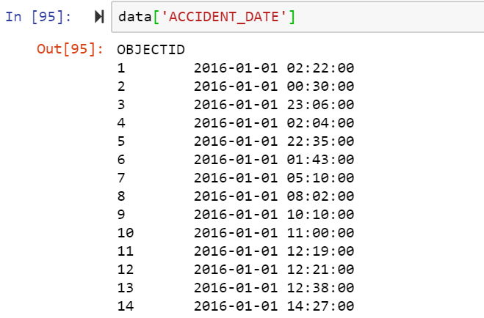

Slide 5
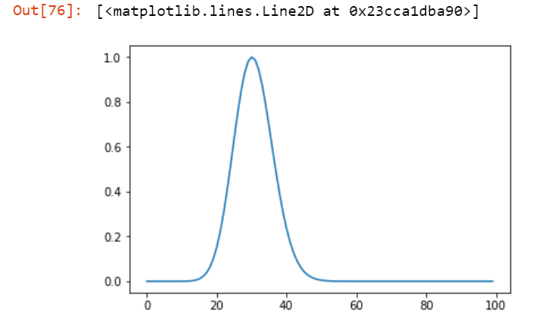
Results - 1st set
Weekdays: n= 39398 L= 30.612276612276613

Slide 6
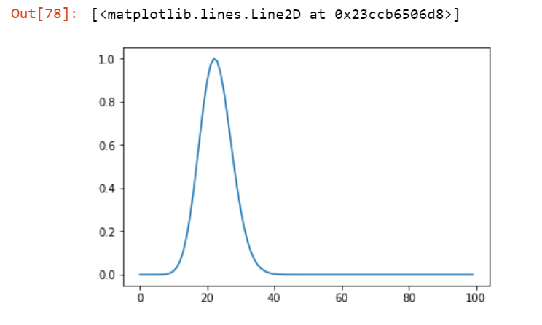
Weekends : n= 518 L= 22.698841698841697

Slide 7
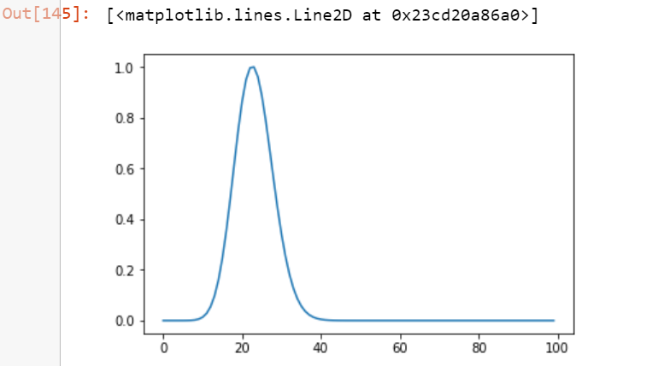
Results- 2nd set
Morning : 6am-8pm: n= 41586 L = 23.077691453940066
Night: 8pm-6pm

Slide 8
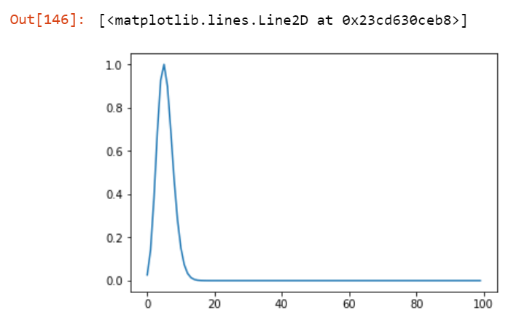
Night : 6pm - 8am: n= 9570 L= 5.394588500563698

Slide 9
Hypothesis testing.
T-test:
Dataset 1 :
Dataset 2:

Slide 10
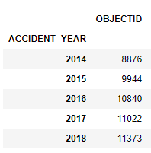
Greensboro Population vs Collisions by Year
Greensboro Population vs Greensboro Collisions
Year | Population
2014 | 282,476
2015 | 285,034
2016 | 287,018
2017 | 290,222
2018 | 294,722

Slide 11
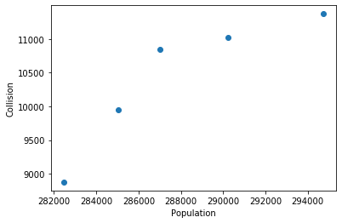
Greensboro Population vs Collisions by Year
Poisson Distribution(𝜆)
𝜆 = n*θ where n is the number of sample and θ is the probability. 𝜆 is the mean and variance of the number of collisions in each year
We can see the increase in the number of collisions over years.
Year | Collisions per 1000 people
2014 | 31.42
2015 | 34.89
2016 | 37.77
2017 | 37.98
2018 | 38.59

Slide 12
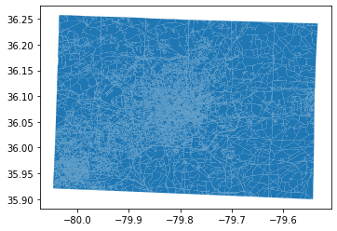
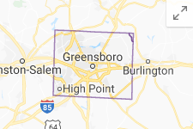
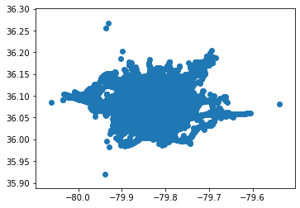
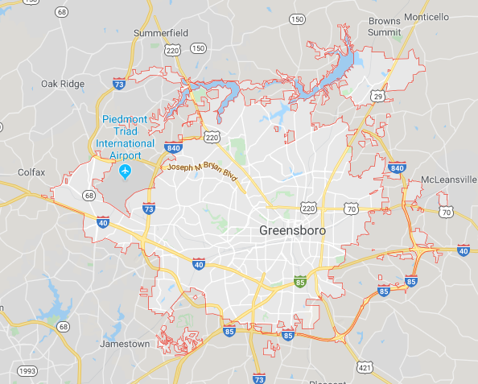
Greensboro Population vs Collisions by Block
Guilford county
Greensboro

Slide 13
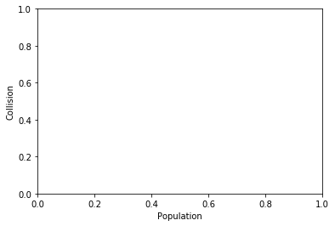

Greensboro Population vs Collisions by Block
Since I need to iterate 52055 points (collisions) and 11028 polygons which belong to 292 blocks, it took so much time to find adequate coding.
H0: There is no difference between each block.
Ha: There is at least one block that has significant number of collisions.

Slide 14
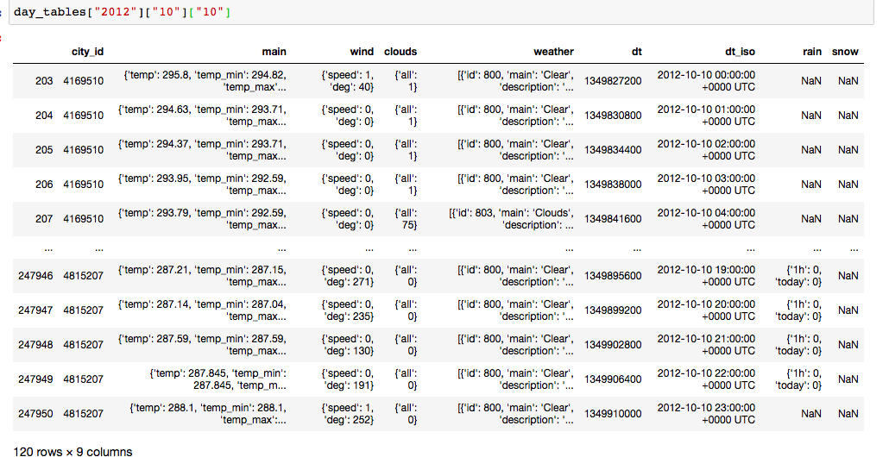
Fatalities Statistics
There is a still a lot to look at
Weather data costed $50 and needed some clean up to look at them.
Data from Open Weather Map inc.

Slide 16
Goal to associate weather data with fatality events
The data needs to be cleaned up and a new method is needed to associate
Fatality times with the weather measurements. Need to apply the analysis to all the observations.
So far nothing yet

Slide 17
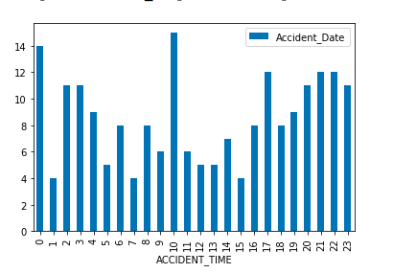
Frequency of fatalities during a certain part of the day
From greensboro data

Slide 18
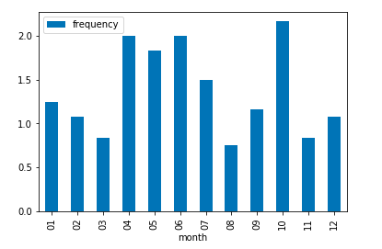
Average number of fatalities for a given month
From 2012 to 2019 from the greensboro data

Slide 19
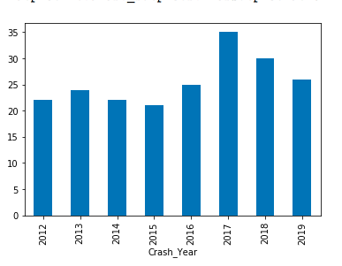
Total crashes per year from the greensboro data

Slide 20
Next goals
Append weather data to the collision data
And try to come up with any conclusions

Slide 21
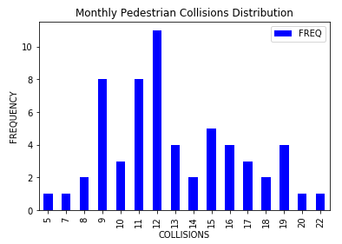
Basic Statistics
Monthly Collisions:
Collision Type | Mean | Standard Deviation | Skewness | Kurtosis
Vehicle | 851.850 | 121.072 | -0.013 | -0.288
Pedestrian | 12.900 | 3.630 | 0.409 | -0.344
Cyclist | 2.532 | 1.365 | 0.439 | -0.715

Slide 22
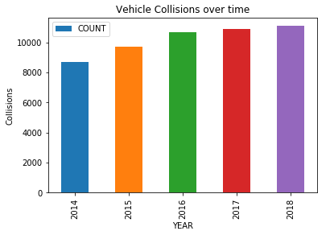
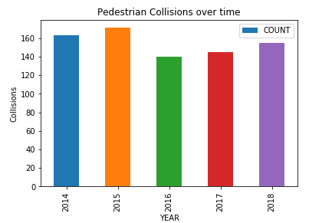
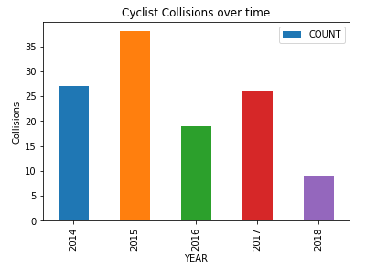
Collisions Over Time
Correlation Coefficients:
Vehicle Collisions: 0.94
Pedestrian Collisions: -0.52
Cyclist Collisions: -0.71

Slide 23
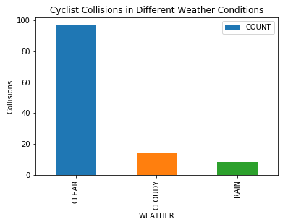
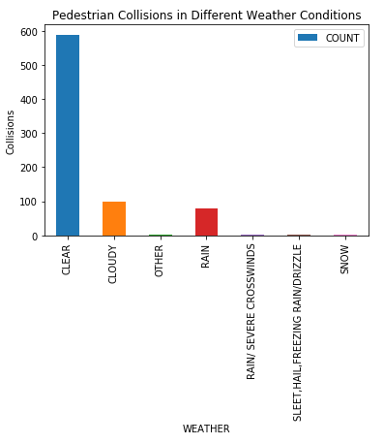
Collisions in Different Weather Conditions
Collision types and weather are independent
Chi-Square statistic p-value: 0.1305

Slide 24
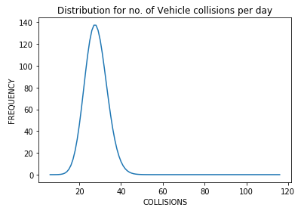
Distribution of Collisions per Day
Collisions within a day
Vehicle: Poisson (27.99)
Pedestrian: Poisson (1.27)
Cyclist: Poisson (1.08)

Slide 25
Intersections Overview
Overall goal is to find the intersections in Greensboro with the highest concentrations of incidents surrounding them and give a visual aid.
Things that need to be improved for this task:
Gain more experience with using the MapBox API for better visuals and data conversion.

Slide 26
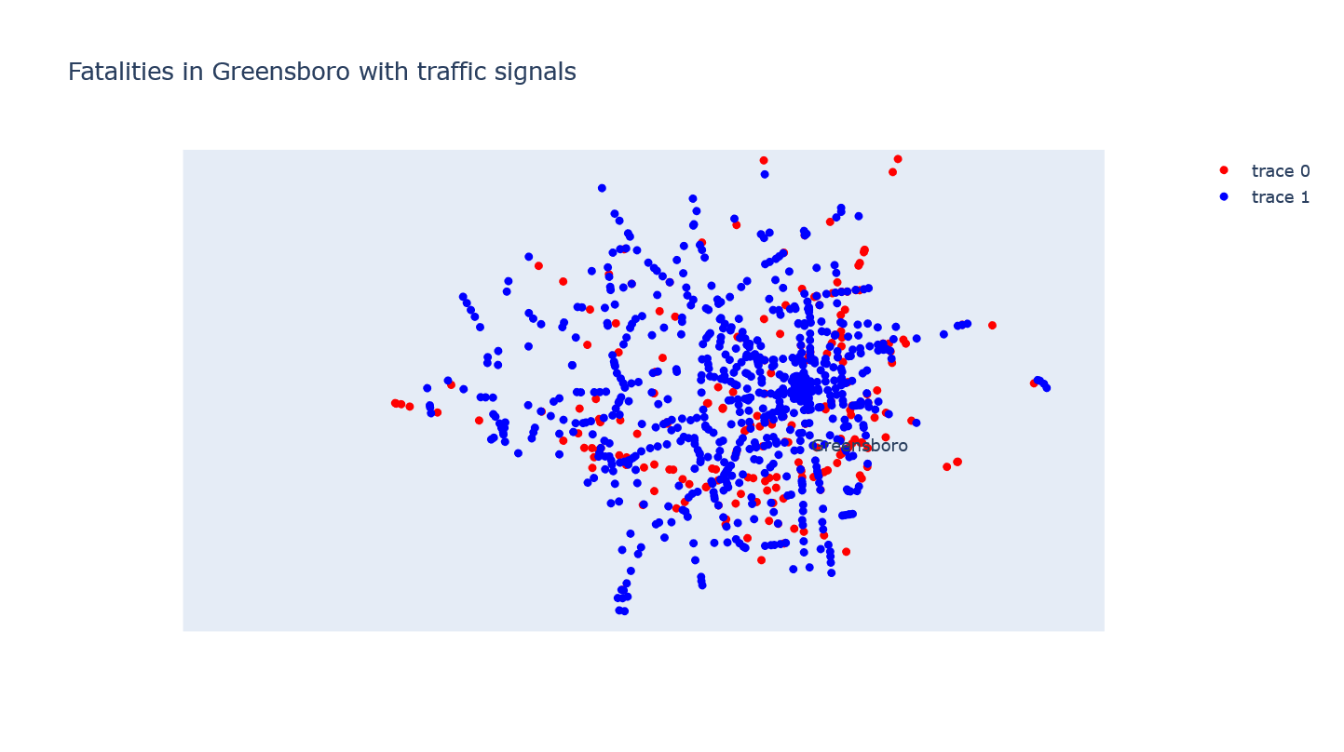
Fatalities and Traffic Signals

Slide 27
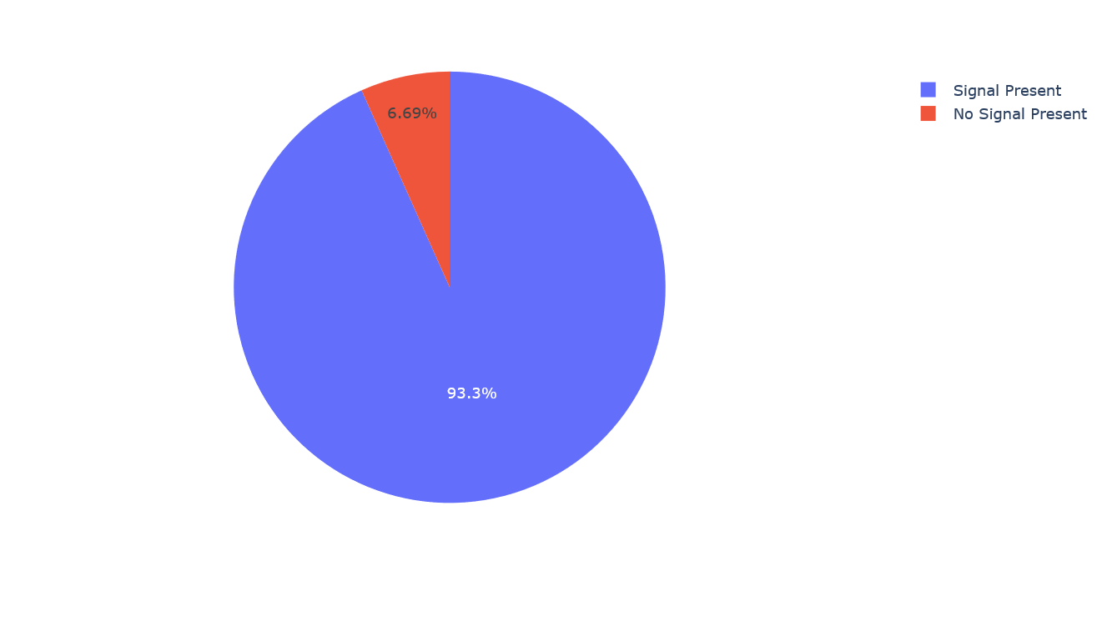

Slide 28
